Slide 1
2018 UN High-Level Meeting on Noncommunicable Diseases
27 September 2018, New York
Outcomes of the third UN HLM on NCDs
October 2018

Slide 2
The official outcomes
The context
1
2

Slide 3
The Context
^{Update from 68th}
^{World Health Assembly}
^{Webinar, 22 july 2015}

Slide 4
Why hold the HLM during the UN General Assembly?
UN General Assembly
Commitments
Resolutions:
Participation:
World Health Assembly
Guidance
Resolutions:
Participation:
Heads of State/Government
Ministers of Health
Primary focus on development
“We, Heads of State and Government, commit to…”
“We urge Member States to…”
Ministers of Health
Primary focus on health
Ministers of Foreign Affairs
Notes:
Before we fully dive into the context of the UN HLM, it’s important to understand why holding the HLM during the UN General Assembly in September was an important advocacy point, despite there being many competing priorities during this high level week in New York.
The main reason to hold the HLM during the high-level week of the UN General Assembly (UNGA) in New York was to ensure that NCDs were once again elevated to the highest political level, and that Heads of State and Government recommitted to action on reducing the burden of NCDs and their risk factors. While the World Health Organization remains the technical body that guides the global NCD and broader health response, the UNGA has a broader mandate to address all development-related issues.
As you can see here, some of the main differences between UNGA and WHA include the tone of resolutions, with Member States committing to an action in UNGA resolutions, versus WHA resolutions, which serve as guidelines and suggested actions for governments to take. WHA’s main focus is on health and is attended primarily by Ministers of Health. UNGA, however, is focused on development and global issues that require international cooperation – during the high-level week, Presidents and Prime Ministers, and Ministers of Foreign Affairs attend. If there are health-related issues during UNGA meetings, Ministers of Health and other departments also attend.

Slide 5
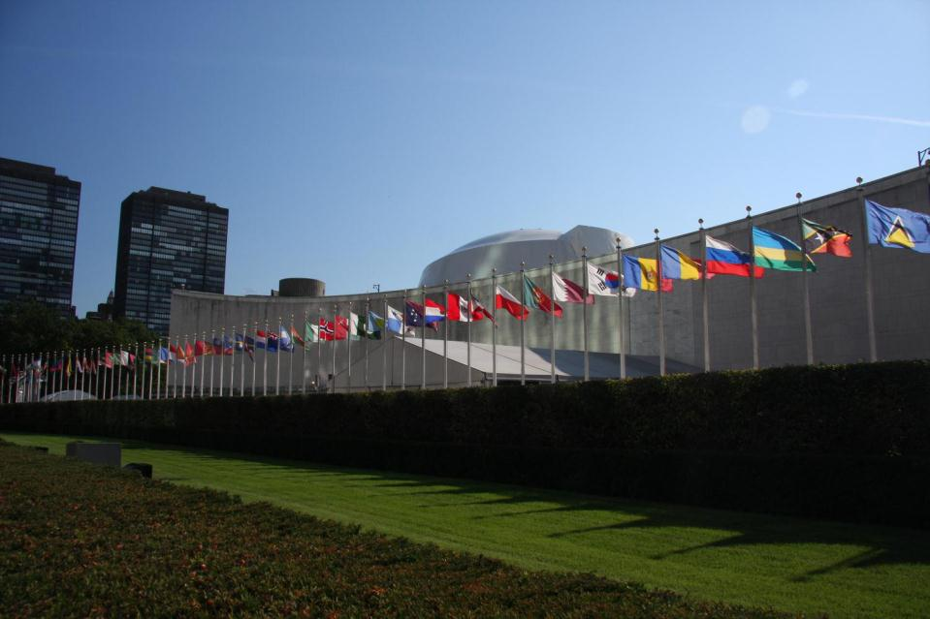
2018 UN High-Level Meeting on NCDs
2011 Political Declaration
2018
Political Declaration
First High-Level Meeting on NCDs
(World Leaders)
Third High-Level Meeting on NCDs
(World Leaders)
2014 Outcome Document
Second High-Level Meeting on NCDs (Ministers)
Notes:
The first UN High-Level Meeting on NCDs took place in September 2011 during the UN General Assembly, and resulted in a Political Declaration signed by World Leaders with 22 global commitments to reduce the burden of poor health and death due to NCDs and their risk factors. Following the initial HLM, governments met in July 2014 to review progress made since 2011, and adopted an outcome document with four, time-bound commitments to accelerate action on NCDs at the national level. This review had no Heads of State or Government in attendance, and was instead attended at the ministerial level. The third and most recent HLM on NCDs took place in September 2018 and was attended by world leaders and ministers.

Slide 6
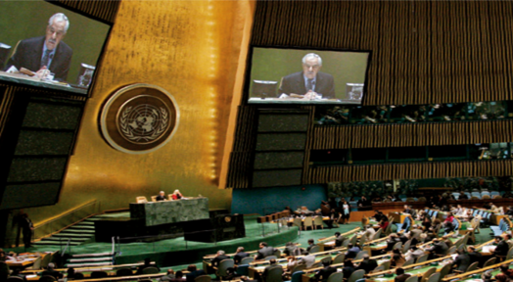
Why was it important?
A global multilateral process for global issues
All national governments at the highest political level
Elevated health from the technical to political realm
Opportunity to focus attention, reiterate commitments, review progress, and agree the way forward
Galvanised consensus on international cooperation
Resulted in national political commitments and targets
Notes:
As mentioned before, high-level meetings at the UN are important multilateral processes that elevates a technical issue normally discussed at the World Health Assembly to a political priority for discussion as a priority for international development and cooperation.

Slide 7
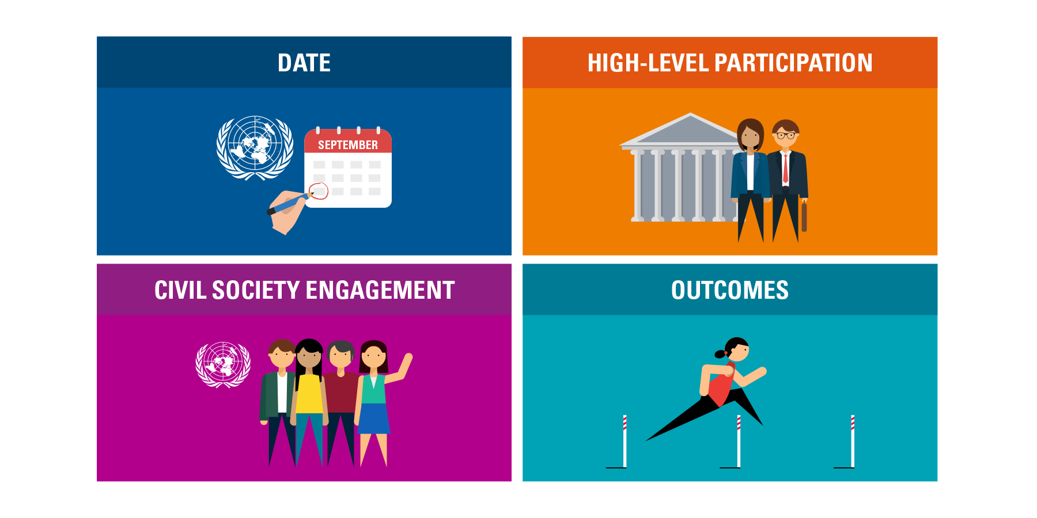
What are the lessons learnt?
http://www.un.org/en/ga/search/view_doc.asp?symbol=A/RES/72/274
Notes:
We know that the process is as important as the actual meeting itself, as it decides the date, level of participation, how stakeholders will be involved, and what the outcome will be. The structure of the one-day HLM was decided in April of 2018 by what’s called a modalities resolution, which is negotiated by Member States in New York. The modalities document decided that the HLM would be a one-day meeting in September, called for participation at the highest level possible, committed to hold an interactive stakeholder hearing, and that the outcome would be a Political Declaration.
The full text of the modalities document is available via the link at the bottom of the slide.

Slide 8
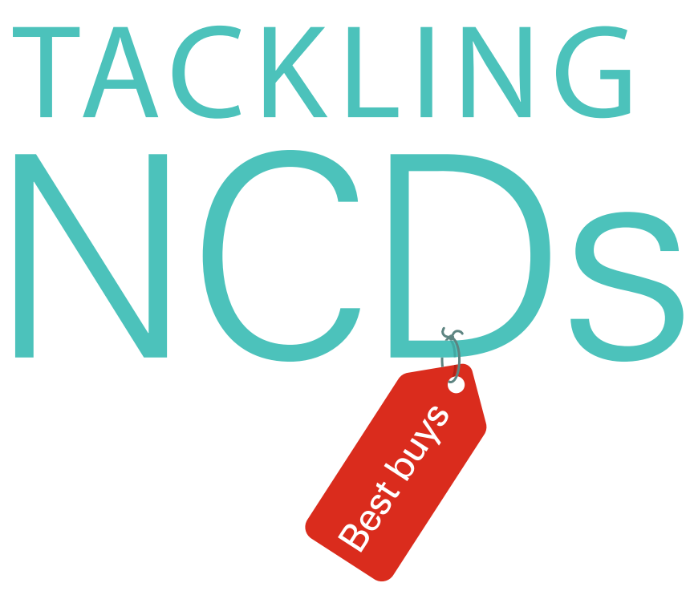
What was the context? 6 positives
NCDs included in UN Sustainable Development Goals
Global awareness of the scale, burden and threat
Longstanding political leaders’ commitment
Plethora of plans, political commitments and targets
Evidence base and consensus on solutions
Stronger civil society movement
Notes:
The 2018 HLM came at an interesting time in the NCD response, as global awareness of NCDs and their risk factors has increased since 2011, and many governments have implemented policies and programmes to reduce their burden. This HLM was also the first time NCDs were reviewed since the adoption of the Sustainable Development Goals, and was an opportunity to highlight how addressing NCDs and their risk factors will help to achieve the SDGs. And finally, civil society has grown – both in size and strength – since 2011, and is a crucial driving force in the NCD response.

Slide 9
What was the context? 6 negatives
Slow and uneven progress in NCD response globally
Countries’ conflicting priorities, sense of multiple crises
Political inertia and opposition to “new and ambitious”
Still painfully inadequate resources
Interference of powerful multinationals in public policy
Absence of a people’s movement
Notes:
While there is greater awareness of NCDs and their risk factors, the context in which the third HLM took place also had some challenges. The latest WHO NCD Country Profile reports show that progress across the board is slow and uneven, and at the current rate, insufficient to meet the global 25x25 targets and SDG3.4. The political context that has been increasingly apparent was the lack of desire to commit to anything new or ambitious, especially if it seemed to repeat prior existing commitments. The lack of financing for NCDs remains a barrier to success, as does the absence of a people’s movement – to the general public, NCDs are still a mystery. And, unlike any other health issue, the NCD response battles with the interference of powerful and well resourced multinational companies that produce the main commercial determinants of health.

Slide 10
The Outcomes
Notes:
Keeping this context – both the positives and challenges - in mind, what were the outcomes of the HLM?

Slide 11
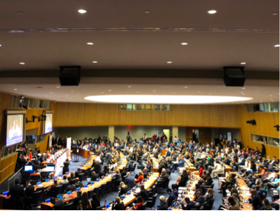
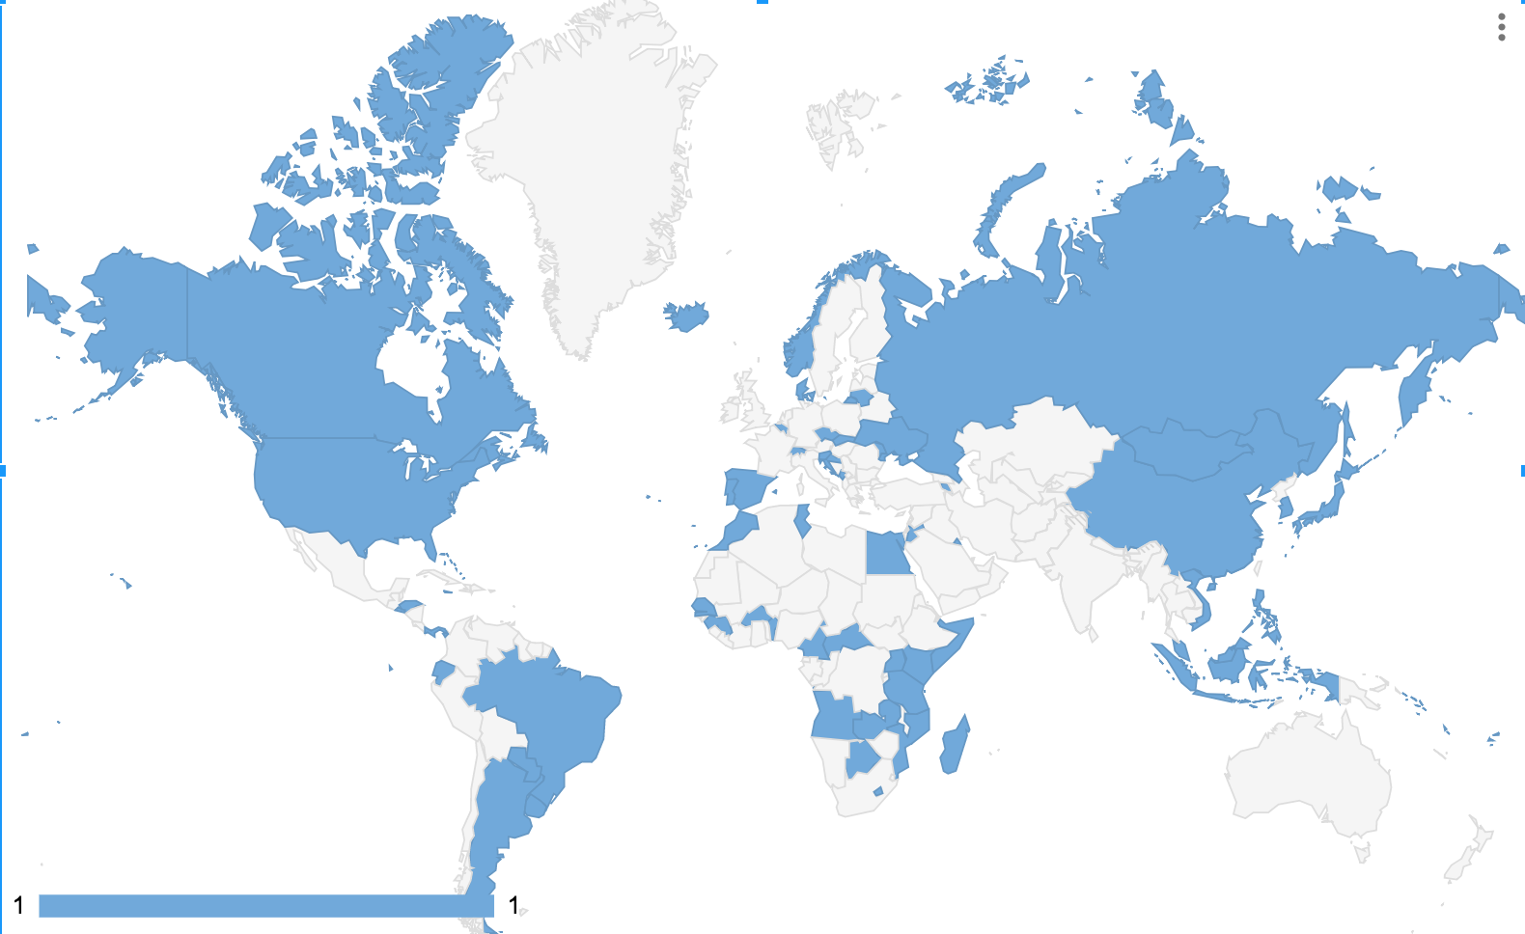
What happened at the 3rd UN HLM on NCDs?
Government attendance
Heads of State/Government: 23
Ministers: 55
Vice Ministers: 4
Notes:
A total of 23 Heads of State and Government, 55 Ministers, and 4 Vice Ministers attended the HLM on NCDs. The Heads adopted the Declaration during the opening segment, after which the concurrent plenary and multi-stakeholder panel sessions began. 80 countries delivered statements during the plenary segments, while 30 made statements during the multistakeholder panels. In addition to the official statements made during the HLM itself, many countries made statements at other events and meetings during the UNGA week in which they addressed NCDs.

Slide 12
Programme Structure of the UN HLM on NCDs
Thursday, 27 September 2018
Opening Segment
10:00 – 11:00
Plenary
Multi-stakeholder panel 1
11:00 – 13:00
Lunch break
13:00 – 15:00
Plenary
Multi-stakeholder panel 2
15:00 – 17:00
Closing Segment
17:00 – 18:00
Notes:
The of the one-day HLM was as you can see here, with the opening and closing segments and the plenary sessions taking place in the same room. The plenary is where governments made general statements about the NCD response and their commitment to accelerating it, while the concurrent multi-stakeholder panels had specific themes for discussion. The theme of the morning panel was Strengthening health systems and financing for the prevention and control of NCDs, on each country’s path towards achieving universal health coverage, including through sharing evidence-based best practices, scientific knowledge and lessons learned. The theme of the second panel was Opportunities and challenges in engaging Governments, civil society and the private sector at the global, regional and national levels to promote multisectoral partnerships for the prevention and control of NCDs and the promotion of healthy lifestyles.

Slide 13
What happened at the 3rd UN HLM on NCDs?
Political Declaration
Adopted during opening segment
Country statements at the HLM
A total of 80 countries delivered statements during the plenary segments
30 countries made statements during the two multistakeholder panel sessions
Additional statements made during various side events
A summary of MS statements is available here
All MS statements are available here
All stakeholder statements available here
Notes:
NCDA has summarized all statements made by countries during the plenary segments and the panel sessions, which can be accessed via the first link at the bottom. The map to the right highlights which countries at HoS/G attendance at the HLM. Additional resources include the UN’s website with the full text of all Member State statements, as well as statements from civil society and other stakeholders. Of the statements from stakeholders, only a few were able to be delivered during the panel sessions, but all were encouraged to submit statements in writing.

Slide 14
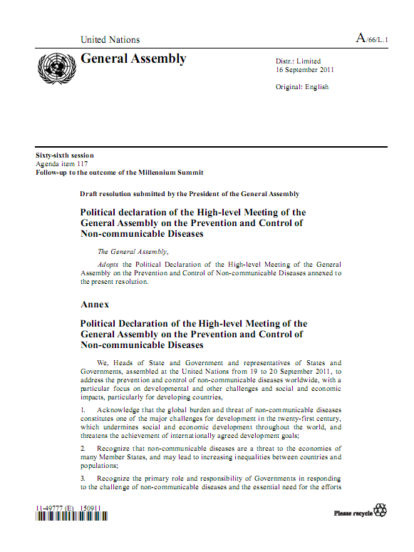
The 2018 Political Declaration on NCDs
A Snapshot of the Political Declaration
13 new commitments
Reaffirms 2011, 2014 + 2030 Agenda
Strengthens role of HoS/G
Commits to a 5x5 agenda
Reaffirms WHO leadership
Work with civil society + PLWNCDs
Summary of commitments in the PD
Notes:
The Political Declaration of the third UN HLM, adopted in the opening segment, contains a total of 13 new commitments and reaffirms existing ones from 2011 and 2014, as well as those in the 2030 Agenda for Sustainable Development. You can see a few of the commitments here, including working with civil society and people living with NCDs. For a summary of all commitments in the Political Declaration, please follow the link at the bottom of the slide.
Overall, the 2018 Political Declaration is fairly unambitious and contains no new, time bound commitments for governments. Additionally, the PD establishes that the next HLM on NCDs will take place in 2025, a full seven years from this one, which is far too long a gap to review progress. We have seen the slow progress between 2014 and 2018, and a review in 2025 provides little time for governments to course-correct before the 2030 deadline of the SDGs. Additionally, 2025 is the end date for WHO’s 25x25, and the data from this will not be fully analysed or ready to report until 2026. Therefore, civil society and other stakeholders must hold governments to account to ensure that this seven year period is not one of procrastination.

Slide 15
Civil Society Priorities vs. Outcomes
Notes:
The NCD Alliance and broader NCD community arrived at a set of 6 overarching priorities for the HLM on NCDs, following extensive consultation with the network.
Priority 1: for the first time in an NCD outcome document, the 2018 PD included language on promoting meaningful engagement of civil society and amplifying the voices of and raising awareness about people living with and affected by NCDs.
Priority 2: while governments recognised the need to increase investments for NCDs, there were no financial commitments made to back up the recognition that NCDs are seriously underfunded.
Priority 3: There are several references to addressing childhood obesity, including paragraph 12 in the PD that includes language on breastfeeding, promoting regular physical activity, and healthy environments; and paragraph 23 on implementing cost-effective and evidence-based interventions to halt the rise of overweight and obesity.
Priority 4: the PD fell far short of including language on adopting fiscal policies to promote health, and instead made weak reference to promote and implement policy, legislative and regulatory measures, including fiscal measures, as appropriate, in paragraph 21.
Priority 5: paragraph 35 addresses strengthening and reorienting health systems towards the achievement of universal health coverage, and paragraph 36 addresses promoting increased access to affordable, safe, effective and quality medicines and diagnostics and other technologies.
Priority 6: the final priority on accountability involved embracing independent accountability. However, the text of the PD does not include language on independent accountability, and instead says to establish or strengthen transparent national accountability mechanisms.
A detailed analysis of our priority recommendations against the outcomes of the HLM, please consult the analysis we produced, available on our website. (link is on slide 19 with post-HLM resources).

Slide 16
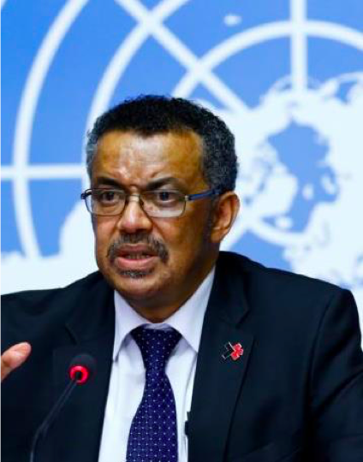
Call for political leadership from WHO DG
Notes:
Despite the seven year gap, there are some initiatives to hold governments to account and ensure progress is made. At the HLM, WHO’s Director General suggested the establishment of a Presidential Coalition for NCDs, which would begin with 6-12 Heads of State and Government to champion NCDs and the tried and tested interventions that work. As part of this Coalition, Heads would likely evaluate progress against existing NCD commitments in 2023, which would provide a much-needed midpoint review.

Slide 17
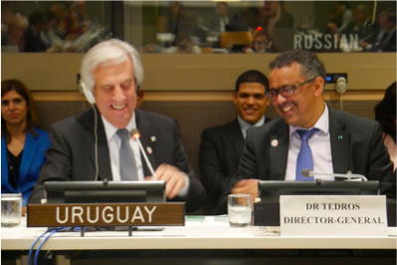
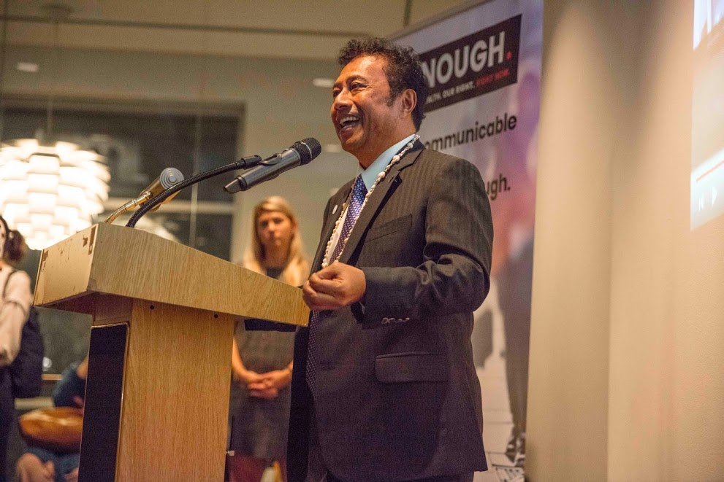
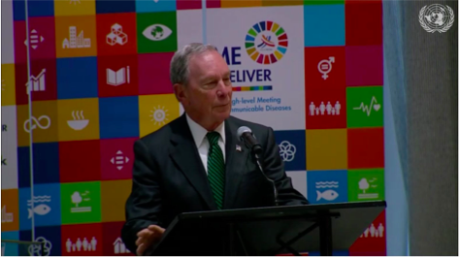
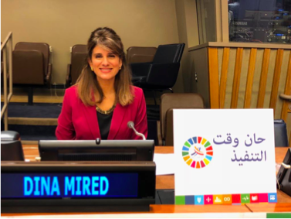
High-level attendance
Notes:
One of the biggest benefits of convening the third HLM on NCDs during the UN General Assembly was the high-level attendance, including:
President Tabare Vazquez of Uruguay,
President Thomas Remengesau of Palau,
other high-level persons such as
* Princess Dina Mired of Jordan,
Zoleka Mandela,
Michael Bloomberg.
The high-level attendance and the media attention they brought with them – both on social media and in other media outlets – helped to further elevate NCDs during a busy week.

Slide 18
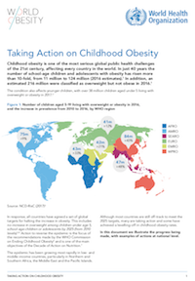
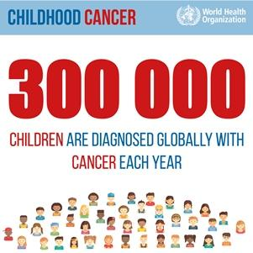
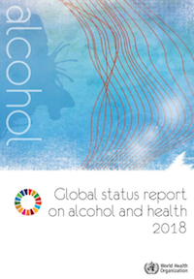
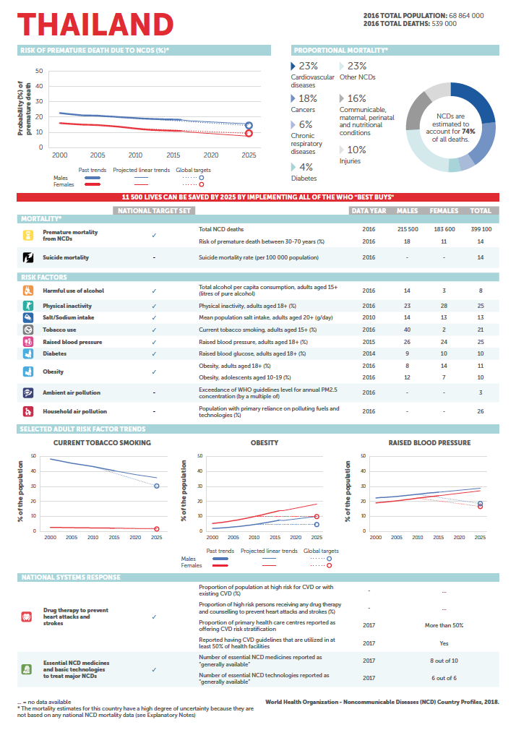
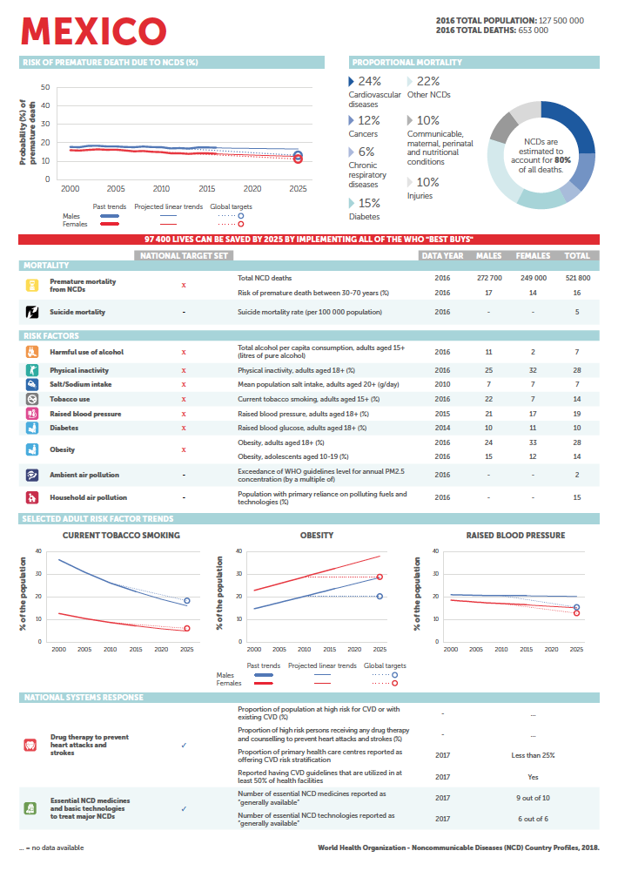
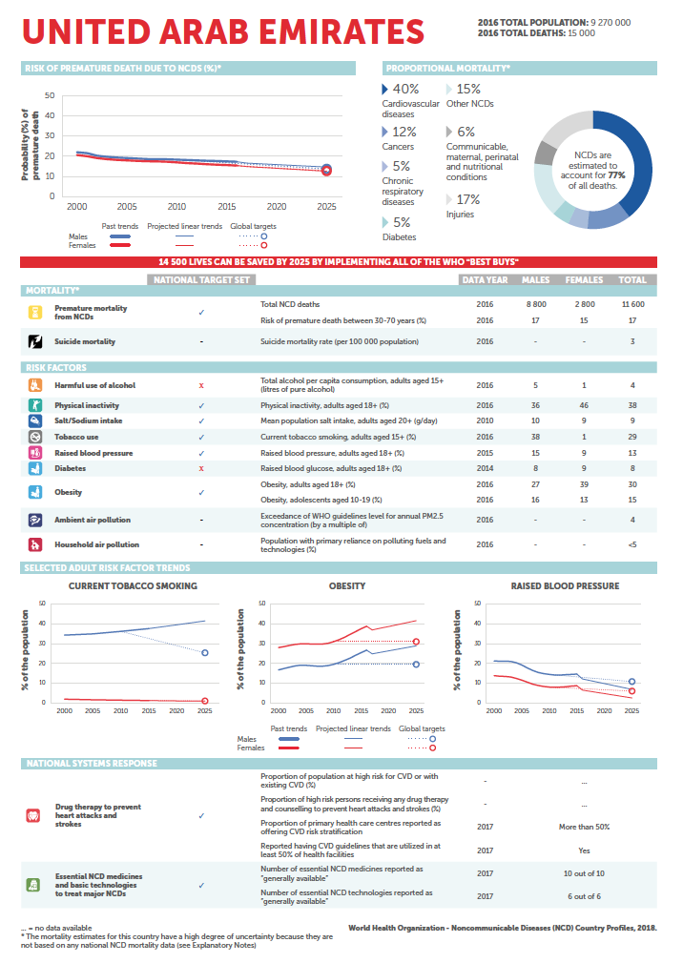
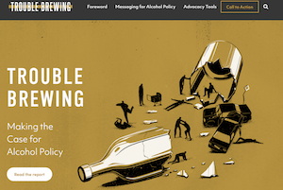
Key Launches during HLM3 / UNGA73
NCD Countdown 2030
WHO NCD Country Profiles 2018
WHO Global Status Report on Alcohol 2018
SAFER package to reduce harmful use of alcohol
Trouble Brewing - Making the case for alcohol policy
WHO's childhood cancer initiative
Global Coalition for Circulatory Health White Paper
Taking Action on Childhood Obesity
NCD Alliance and Resolve to Save Lives partnership to eliminate trans-fatty acids
Healthy Caribbean Coalition 10 year anniversary report
Notes:
During the UNGA week, quite a few new reports and initiatives were launched.

Slide 19
Post-HLM Resources
Initial highs and lows of the 2018 HLM on NCDs
Summary of country statements made at the HLM
Detailed analysis of the 2018 Political Declaration against NCDA’s recommended language
2-page summary of commitments in the PD
Civil society statement on the 2018 Political Declaration
Media release template letter
Notes:
Finally, the NCD Alliance has prepared several resources for advocates to use in their post-HLM work, as seen here.

Slide 20
What’s next?
The HLM on NCDs is not a cliff-edge!
Continued momentum to hold governments to account for existing and new commitments
Engage in national and regional advocacy to shape health-promoting policies and interventions to accelerate the NCD response
First UN High-Level Meeting on Universal Health Coverage, Thursday, 26 September 2019
Advocacy Priority for HLM on UHC: ensuring a comprehensive, lifecourse approach to UHC that spans the continuum of care

